Slide 1
Apple Yield – 4 US States
UTS Data Science Interim Project – Zhitan Wu

Slide 2


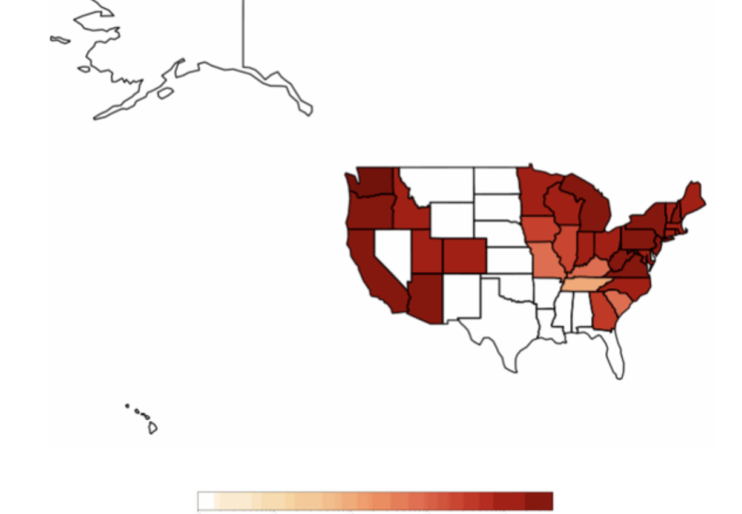

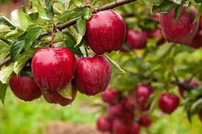
Overview and Introduction
Project Focus: Investigate climate-related data by analyzing a dataset sourced from airports.
Why do this study with airports?
Offers a broader range of climate-related features at airports in 4 US states such as temperature and wind speed. While apples are not directly relevant, airports provide a more comprehensive set of environmental data that is crucial for our analysis.
Features a combination of environmental factors that are typically not found in other datasets.
Provides an outlook for understanding regional climate variations.

Slide 3
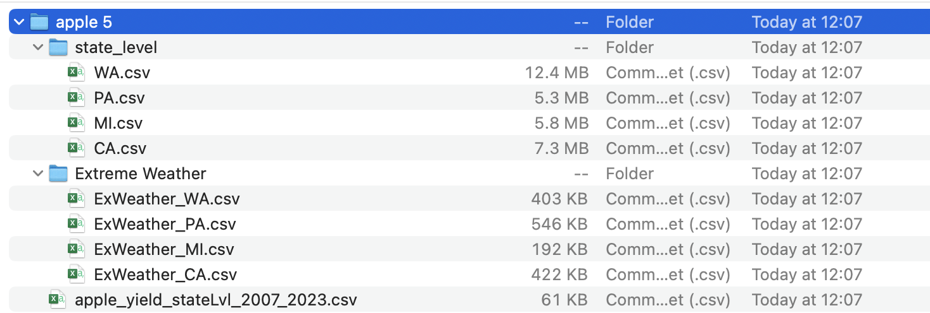
Data Collection & Preprocessing (1)
State/County Level Attributes: Statistics such as place names, weather features, geopolitical features, year and date. This is sequential, time-series data.
Extreme Weather Attributes: Damage statistics such as property and crop, injuries and deaths, type of weather event, dates when each weather event occurred.

Slide 4
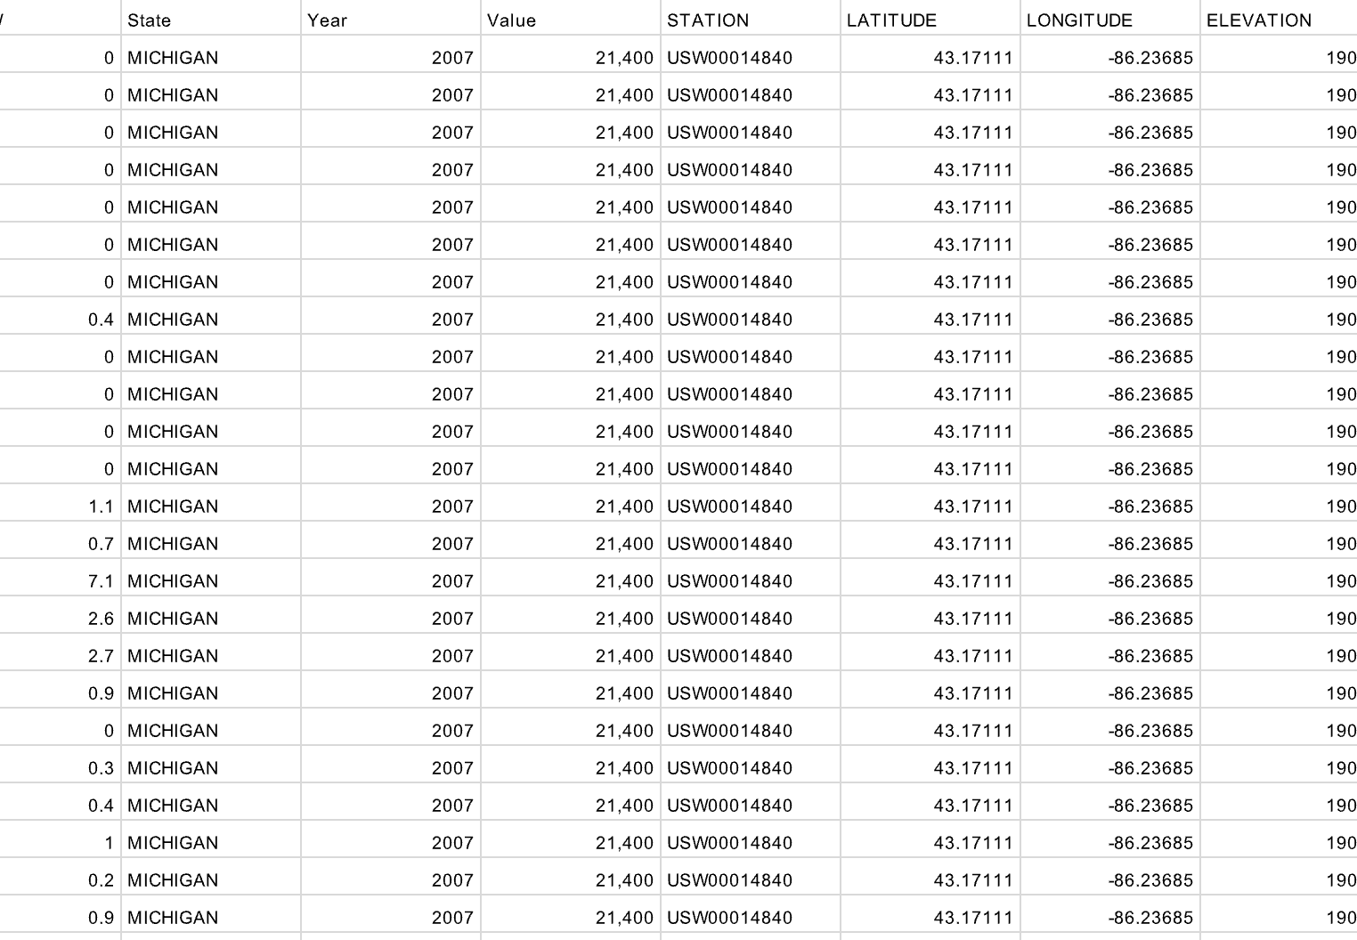
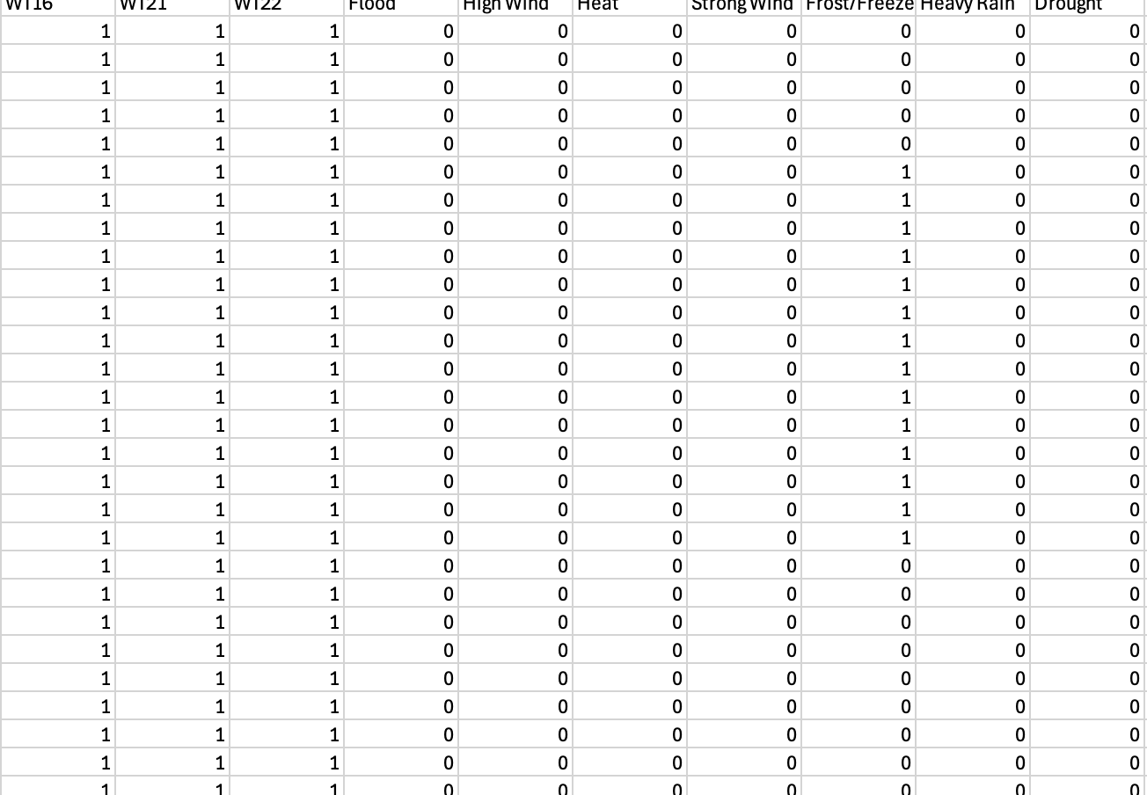
Data Collection & Preprocessing (2)
Focused on the data from 2007 to 2023.
Filtered the name attribute for those with ‘airport’.
Retained the name, date, and non-empty weather features.
Dropped attributes if there are no values; interpolation was used.
Converted the dates to date-time objects.
Implemented a one-to-many mapping between yield values and dates (for each state).
Extreme weather features were incorporated as one-hot-encoded attributes.
Snippet of Preliminary Results – Early Stage
Snippet of Final Results – Finished Stage
Notes:
Some Preprocessing Steps Taken:
- Focused on 2007 to 2023, since there was not enough data that related to airports in 2006 and 2024.
- Filtered the name attribute to preserve only those with ‘airport’.
- Retained the name, date, and non-empty weather features.
- Dropped attributes if there are no values in it; interpolation was used on those attributes with some values to fill in missing values.
- Converted the dates to date-time objects, whereby the day within the entire date is the first element to work with. Then separate columns are created for the day in the year and the year itself, for machine learning models to utilize it more effectively.
- Implemented a one-to-many mapping between yield values and dates (for each state).
Extreme weather features were incorporated as one-hot-encoded attributes. If a date in the merged dataset falls within a specified range and the extreme weather event resulted in significant casualties or total property and crop damage exceeding $100,000, it is marked accordingly.

Slide 5
Results: Summary Statistics (Bottom is Michigan, Top is Pennsylvania)
Attribute | IQR | Minimum Value | Maximum Value | Median | Mode | Range | Standard Deviation | Variance | Mean
PRCP | 0.05 | 0 | 6.59 | 0 | 0 | 6.59 | 0.329 | 0.108 | 0.116
AWND | 3.58 | 0 | 22.82 | 4.03 | 2.91 | 22.82 | 3.044 | 9.269 | 4.822
PGTM | 506 | 0 | 2359 | 1349 | 1353 | 2359 | 509.648 | 259741.229 | 1348.39
TMAX | 31 | 11 | 100 | 66 | 83 | 89 | 18.54 | 343.713 | 64.049
TMIN | 29 | -12 | 77 | 42 | 33 | 89 | 17.63 | 310.826 | 42.11
WDF2 | 160 | 10 | 360 | 260 | 310 | 350 | 95.333 | 9088.353 | 227.556
WDF5 | 150 | 10 | 360 | 250 | 310 | 350 | 94.963 | 9018.056 | 224.716
WSF2 | 8 | 2 | 40.9 | 14.1 | 10.1 | 38.9 | 5.535 | 30.635 | 15.043
WSF5 | 10.1 | 2 | 57.9 | 19.9 | 16.1 | 55.9 | 7.883 | 62.138 | 21.122
z
Attribute | IQR | Minimum Value | Maximum Value | Median | Mode | Range | Standard Deviation | Variance | Mean
PRCP | 0.07 | 0 | 4.29 | 0 | 0 | 4.29 | 0.297 | 0.088 | 0.113
SNOW | 0 | 0 | 14.9 | 0 | 0 | 14.9 | 0.918 | 0.843 | 0.22
SNWD | 0 | 0 | 27.2 | 0 | 0 | 27.2 | 3.771 | 14.22 | 1.374
WESD | 0.044 | 0 | 2.46 | 0 | 0 | 2.46 | 0.157 | 0.025 | 0.054
AWND | 4.879 | 1.34 | 25.95 | 9.844 | 13.76 | 24.61 | 3.575 | 12.78 | 9.95
FMTM | 620.986 | 3 | 9999 | 32 | 32 | 9996 | 1039.862 | 1081313.202 | 476.962
PGTM | 1031.745 | 10 | 2356 | 1138.875 | 286.214 | 2346 | 610.534 | 372751.834 | 1055.37
TMAX | 18 | -2 | 104 | 38 | 40 | 106 | 17.605 | 309.922 | 43.101
TMIN | 14.5 | -32 | 77 | 26 | 21 | 109 | 16.114 | 259.655 | 26.796
WDF2 | 89.449 | 10 | 360 | 225 | 215 | 350 | 74.565 | 5559.933 | 222.011
WDF5 | 95 | 10 | 360 | 220 | 220 | 350 | 76.826 | 5902.205 | 218.599
WSF2 | 7.44 | 6 | 40 | 19.9 | 26.55 | 34 | 5.524 | 30.517 | 20.195
WSF5 | 11.4 | 6.9 | 57.9 | 26.8 | 35 | 51 | 8.095 | 65.542 | 27.515
Notes:
Summary statistics for two of the states that I have done……Michigan and Pennsylvania. Only statistics for the definite numerical attributes are displayed here, since they would usually be the most worthwhile to perform such an analysis.
Traits observed:
PRCP for PA has a slightly smaller IQR than MI, though overall, MI seems the most consistent.
Measures of spread for WDF2 and WDF5 are relatively similar, though the average of values for WDF2 is slightly higher with a slightly larger spread due to a higher variance, IQR and standard deviation.
TMIN has a lower minimum value, has a smaller IQR, mean, standard deviation and variance when compared to TMAX, but TMAX has a slightly smaller range than TMIN.

Slide 6
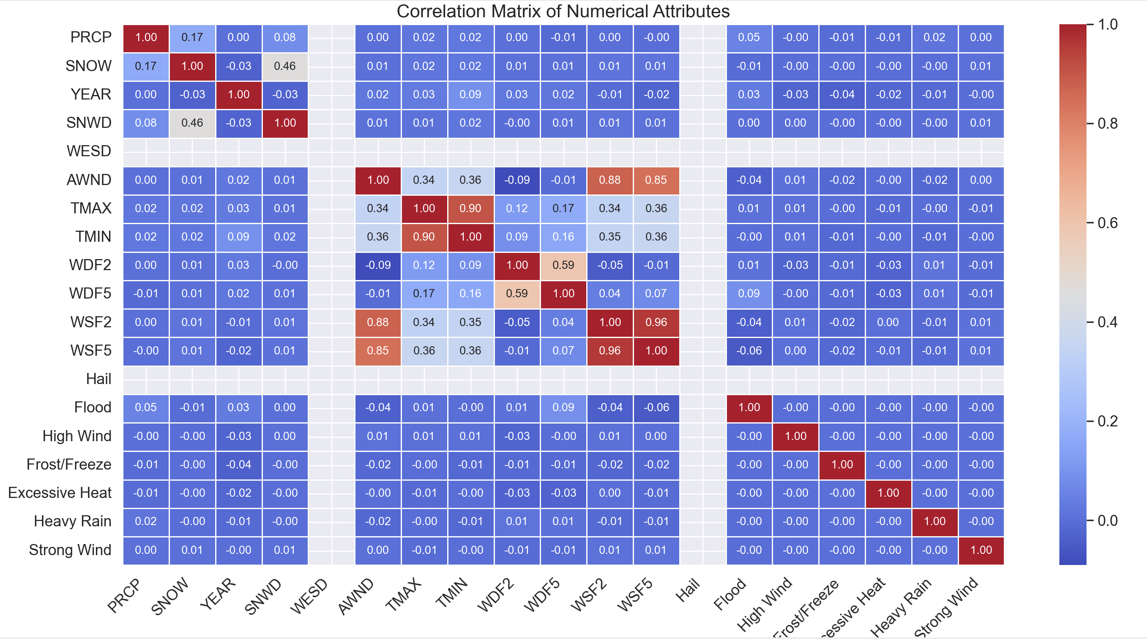
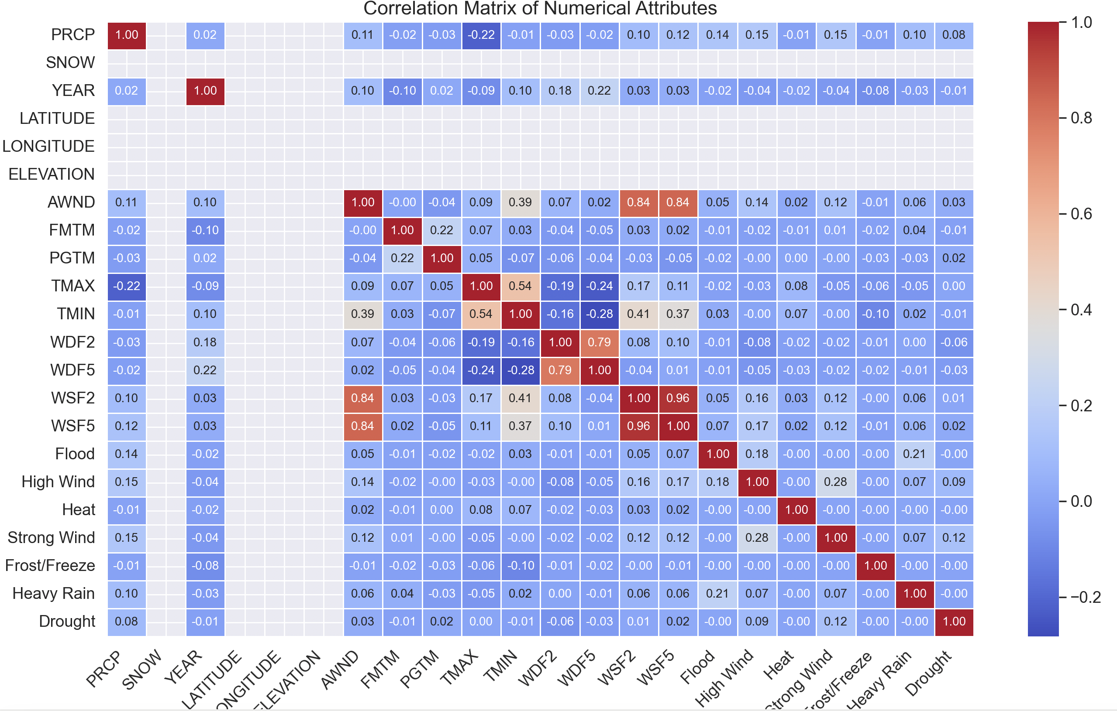
Results: Correlation Matrices
Two of the states’ correlation matrices are displayed here as examples of my work.
For CA,
1. TMAX and TMIN has a strong positive relationship of 0.54, as expected, since temperatures would normally relate with each other.
2. PRCP (Precipitation) negatively correlates with TMAX of -0.22, to suggest that as rainy weather kicks in, cooler temperatures are also brought along with it.
3. Wind related variables such as WSF2, WSF5 and AWND are positively correlated, with WSF2 and WSF5 at 0.84.
For WA,
WDF2 and WDF5 has a moderate relationship with each other (0.59), and TMAX and TMIN have an extremely strong relationship (0.9), stronger than what was seen in CA but still expected.
WESD values are all 0, meaning that variance is constantly near zero. Since it does not change much, it would not correlate with anything.
WA
CA

Slide 7

Results: Association Rules
Converted numerical attributes into four bins that define the data value ranges (low, medium, high, very high) or (25%, 50%, 75%, 100%).
Some association rules;
CA:
If the TMIN is medium (around the 50% mark),
TMAX is medium (around the 50% mark) with a 82% chance .
2. If FMTM is low,
There is a 44% chance that AWND is low as well. If it is the reverse with AWND being low, then the chance of FMTM being low is 94%.
PGTM is high with a 91% chance.
TMAX is medium with a 66% chance.
MI:
If SNWD is low,
WESD is low with 98% chance.
WDF2 is high with 49% chance.
WSF5 is medium with 55% chance.

Slide 8
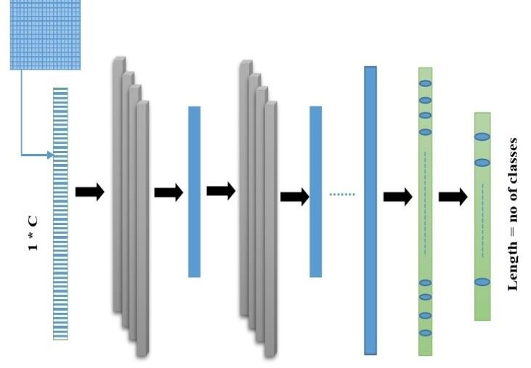
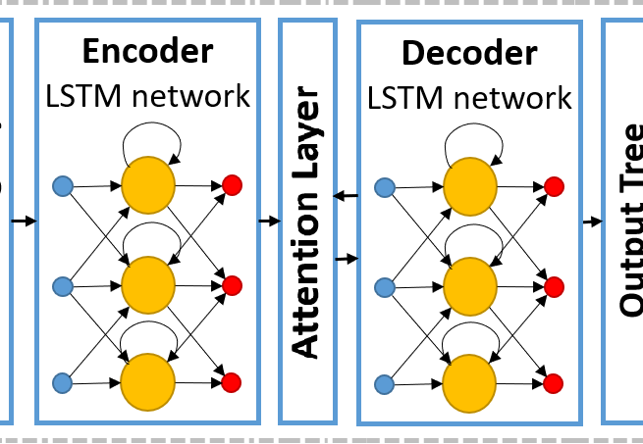
Model Selection
Key machine learning models:
1D – CNN (1 Dimensional Convolutional Neural Network)
GRU (Gated Recurrent Unit)
LSTM (Long Short-Term Memory)
LSTM (with attention layer)
1D-CNN Model Structure
LSTM Model with Attention Layer Structure
Notes:
Key machine learning models:
1D – CNN (1 Dimensional Neural Network) – Useful for feature selection in time-series data. Captures local temporal patterns in sequential data using convolutional filters.
GRU (Gated Recurrent Unit) – Type of recurrent neural network (RNN) that reduces vanishing gradient issues when being computationally efficient compared to LSTM.
LSTM (Long Short-Term Memory) – More advanced Recurrent Neural Network (RNN) to capture long-term dependencies in sequential data, useful for time-series forecasting.
LSTM (with attention layer) – Enhances the capacities of a standard LSTM by assigning different weights to timestamps, allowing the model to focus on the most relevant past information for prediction.

Slide 9
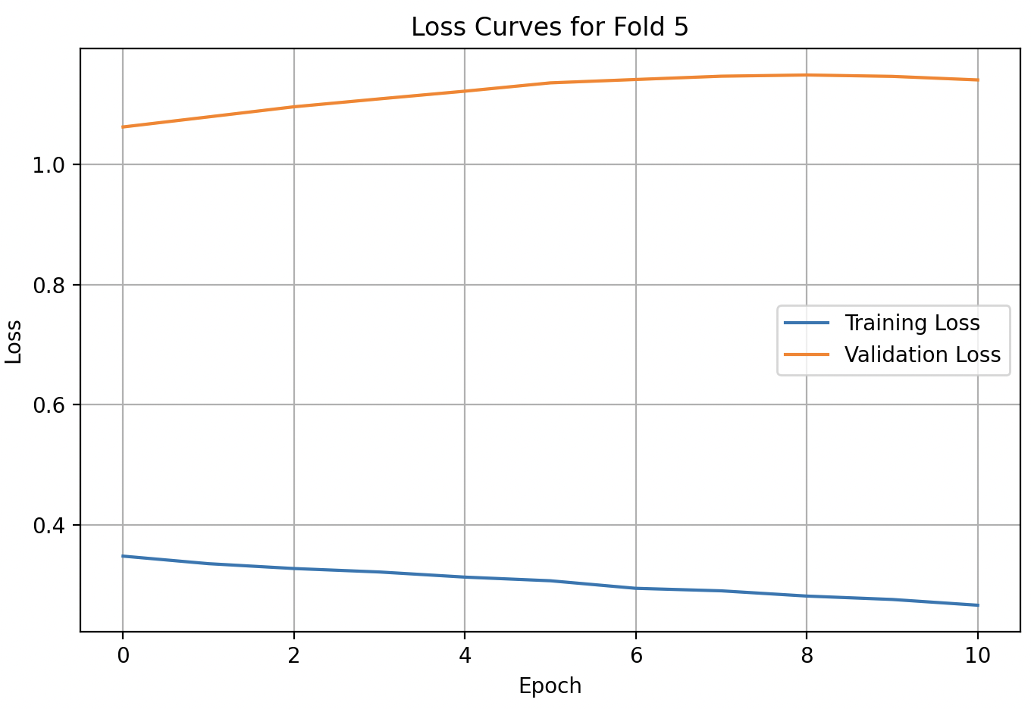
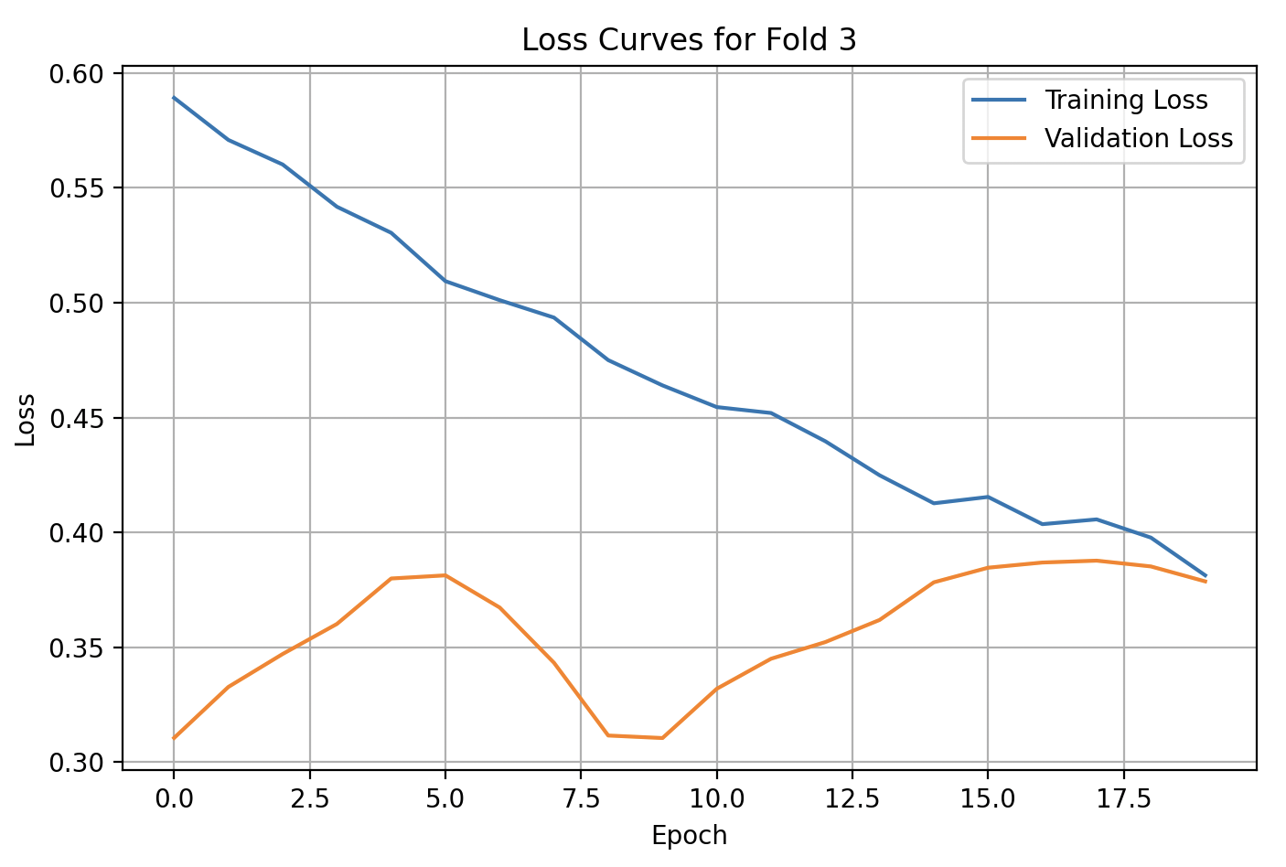
Results: Loss Curves
z
Notes:
For this investigation, each model was trained on 5 folds and a maximum of 40 epochs were used for more sustainable results. To prevent overfitting, Adam and Huber loss algorithms were used alongside L2 Regularisation.
After each fold has finished training, the loss curves are graphed, and two of them are displayed here. Normal results are displayed if the training and validation loss has a decreasing trend, but it is not always possible due to factors such as overfitting with too many epochs, a high learning rate and noisy and inconsistent validation data. The difference between the training and validation loss should also remain minimal.
The ones where the folds of epochs feature the training data being higher than the validation might just be a result of dropout or batch normalization if the gap is minimal, but it can also be possible data leakage or improper data handling if the gap is significant.

Slide 10
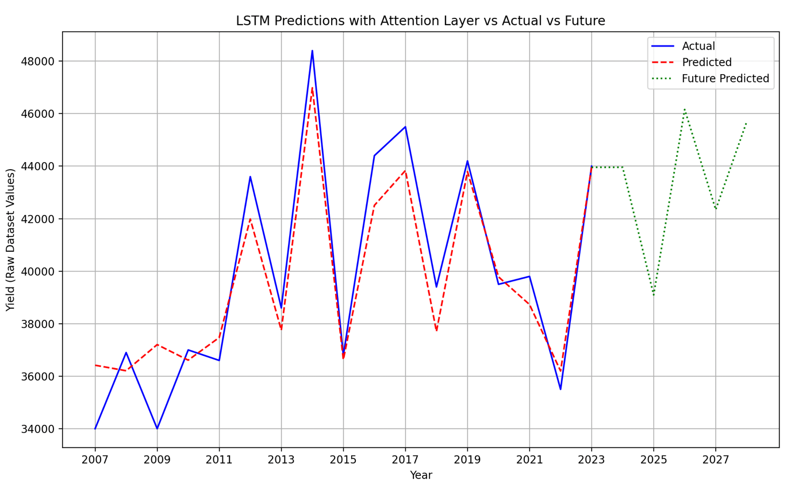
Results: Accuracies
Model/US State | CA | WA | MI | PA
LSTM | 97.66% (Predicted vs actual on seen data) 86.21% (Predictive power on unseen data) | 95.67% (Predicted vs actual on seen data) 87.86% (Predictive power on unseen data) | 84.66% (Predicted vs actual on seen data) 71.52% (Predictive power on unseen data) | 95.34% (Predicted vs actual on seen data) 88.38% (Predictive power on unseen data)
LSTM (with attention layer) | 98.01% (Predicted vs actual onseen data) 79.50% (Predictive power on unseen data) | 88.75% (Predicted vs actual on seen data) 94.55% (Predictive power on unseen data) | 98.01% (Predicted vs actual on seen data) 87.57% (Predictive power on unseen data) | 86.68% (Predicted vs actual on seen data) 84.95% (Predictive power on unseen data)
1D-CNN | 98.27% (Predicted vs actual on seen data) 86.95% (Predictive power on unseen data) | 98.43% (Predicted vs actual on seen data) 92.60% (Predictive power on unseen data) | 94.54% (Predicted vs actual on seen data) 78.40% (Predictive power on unseen data) | 92.70% (Predicted vs actual on seen data) 86.26% (Predictive power on unseen data)
GRU | 96.69% (Predicted vs actual on seen data) 78.66% (Predictive power on unseen data) | 97.52% (Predicted vs actual on seen data) 92.79% (Predictive power on unseen data) | 82.44% (Predicted vs actual on seen data) 66.31% (Predictive power on unseen data) | 96.05% (Predicted vs actual on seen data) 89.25% (Predictive power on unseen data)
z
Notes:
Here is a summary of the accuracies of the models used in the project. The top are the model accuracy statistics and the bottom is a snippet of predictions done by the LSTM (with attention layer) model, with the raw data with future predictions. For a machine learning model to be efficient, it has to have high predictive powers on the raw dataset as well as predicting future values, the latter being the main application of such models.
The study has found that it is most beneficial to use the GRU model to predict future values for the WA dataset since it has the highest accuracy rates for the predicted on seen and unseen data, with the values all being above 90%. This means that the model is efficient at everything that a machine learning model should be capable of. For machine learning models like these and the project in general, it is still possible that even though aspects such as hyperparameter tuning, EarlyStopping callbacks, L2 Regularization, Adam and Huber functions are used, overfitting or underfitting issues can remain. Further, using MAPE as an evaluation metric can also influence the final results since it has bias toward underestimation and is sensitive to small target values.

Slide 11


Conclusion
Demonstrated the power of machine learning models to predict unseen future data. AI-based models (LSTM, CNN, GRU) effectively captured temporal patterns in apple yield data. The best-performing model can be used for yield forecasting, assisting farmers and policymakers.
Attributes such as TMAX and TMIN, and WSF2 and WSF5 have strong relationships with each other – expected since they both either measure the temperature or wind speed.
Approach can be extended to predict yields in other crops and locations.

Slide 12

Future Work
Visualising attention layer for explanations.
Seeking connections with statistic results.
Exploring temporal explanation methods and visualisation.
Hierarchical/Ensemble structure to encode extreme events.

